Slide 1

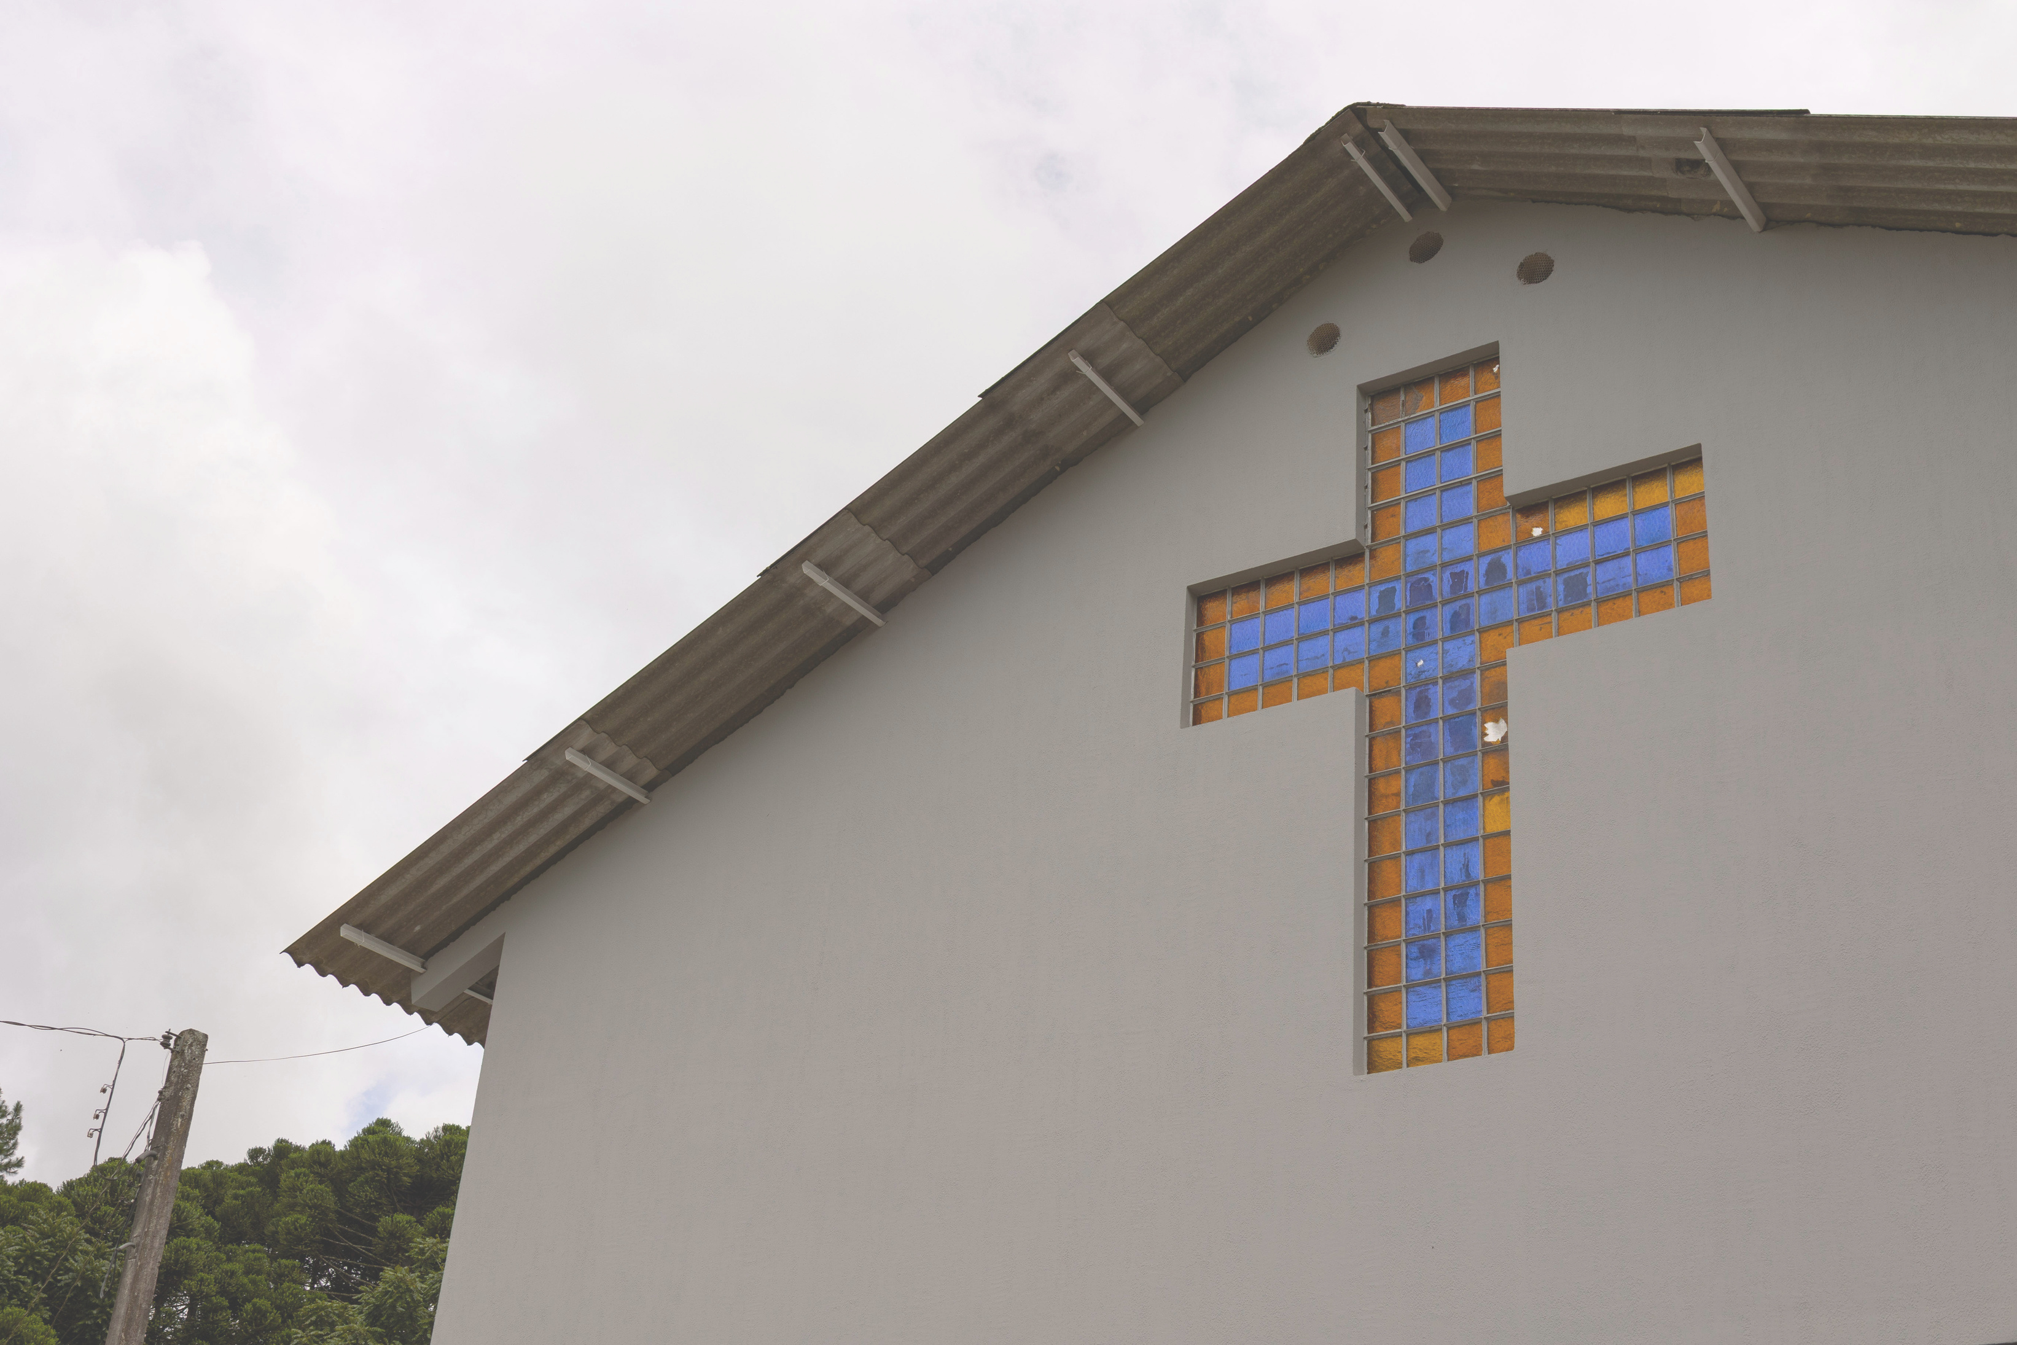

SUNDAY SCHOOL
PROJECTS 2025-26

Slide 2
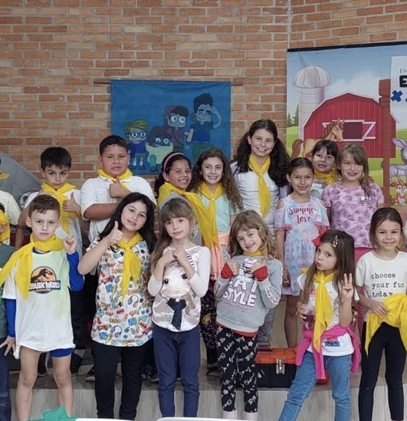
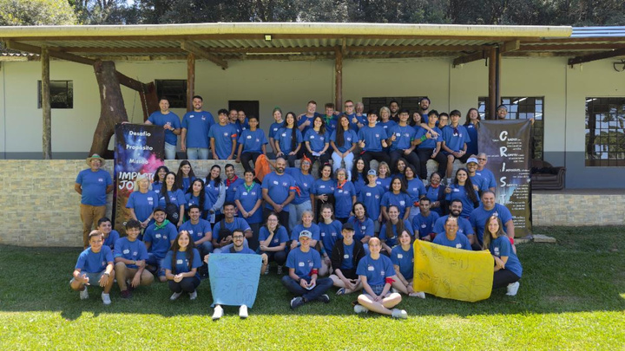
BIBLE CAMP SPONSORSHIP
Goal: As recieved - 60$ per child
The ARCA Bible Camp always welcome camp scholarships. The cost for camp is about $60 (US) per child. Kid's camp is filled with trusted christian mentors, Biblical teaching, and a great fun. Partner with kids in Brazil as they raise money to attend a week away at the ARCA.
BATEIAS, BRAZIL

Slide 3

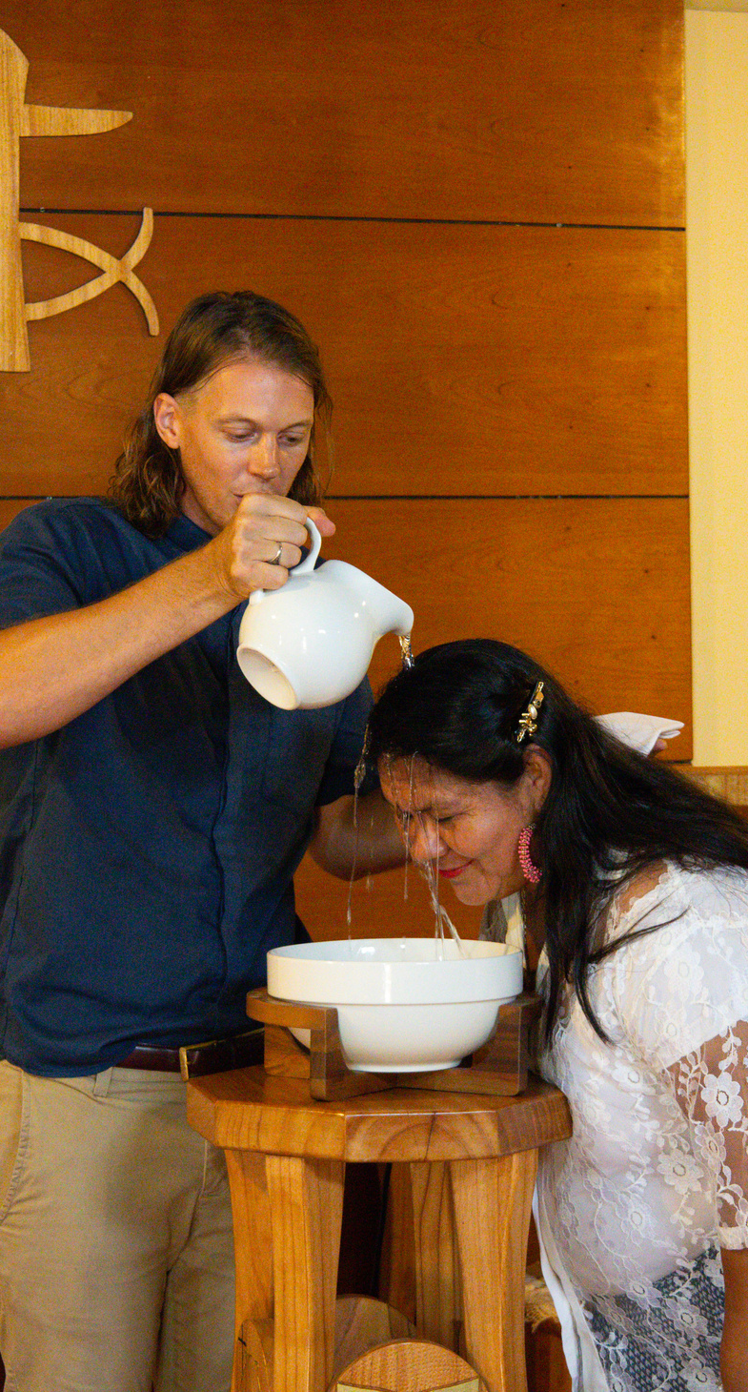
CHURCH LENDING LIBRARY
For their church in Paraguay, Matthew Abel has asked for a special project for resources. Funds raised for this project will provide valuable materials for this young congregation.
VILLARRICA, PARAGUAY

Slide 4
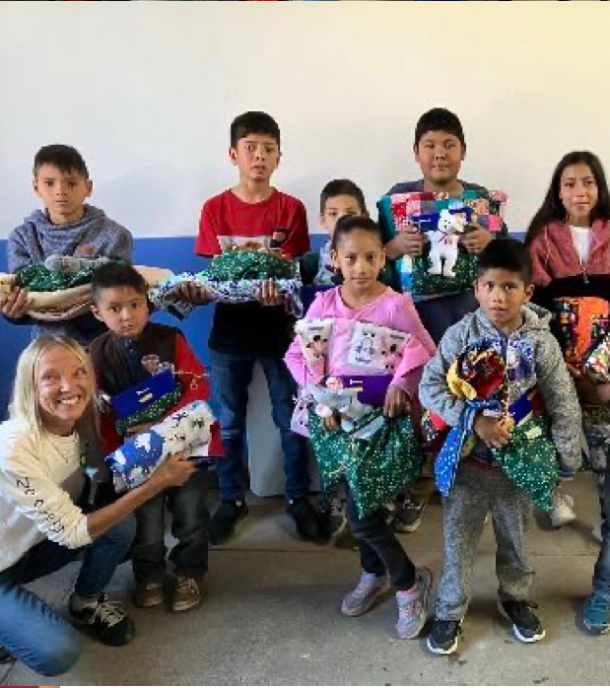
CHRISTMAS GIFT BOXES
Goal: 100 boxes @ 5$ per box
Every year, the Schierkolks raise money to hand out Christmas gift boxes to the children in their community. The number of boxes depends on how much money is raised. Funds that are raised for the project will go towards filling boxes with toys, essential items, books, and ultimately the opportunity to share about Jesus!
JEREZ, ZACATECAS, MEXICO

Slide 5
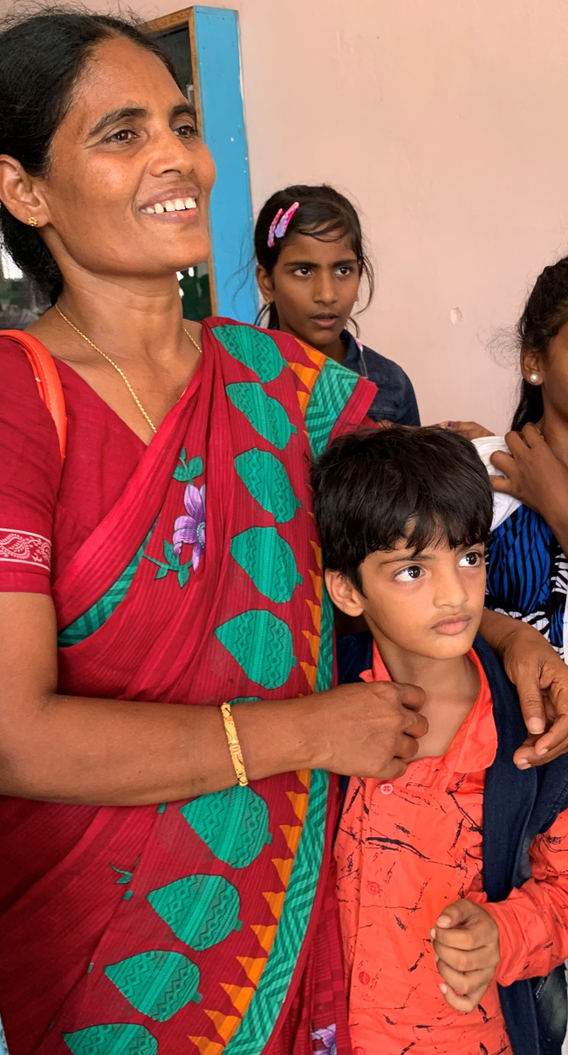
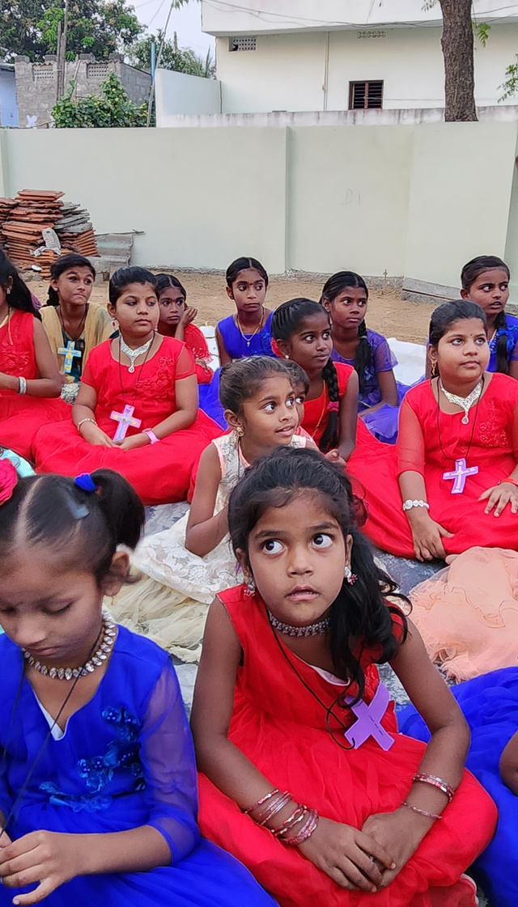
HOREB CHILDREN’S MINISTRY
Goal: 500$
This children's ministry in India disciples youth in the Word of God, while also providing for their physical needs.
CHIRALA, INDIA

Slide 6
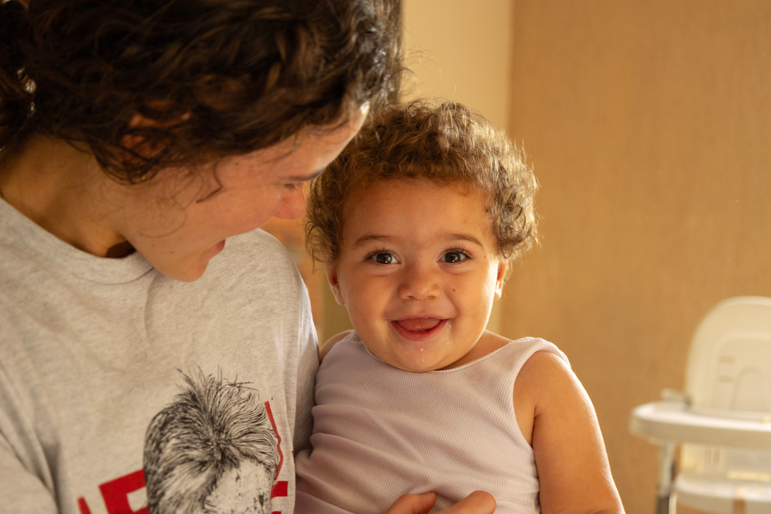
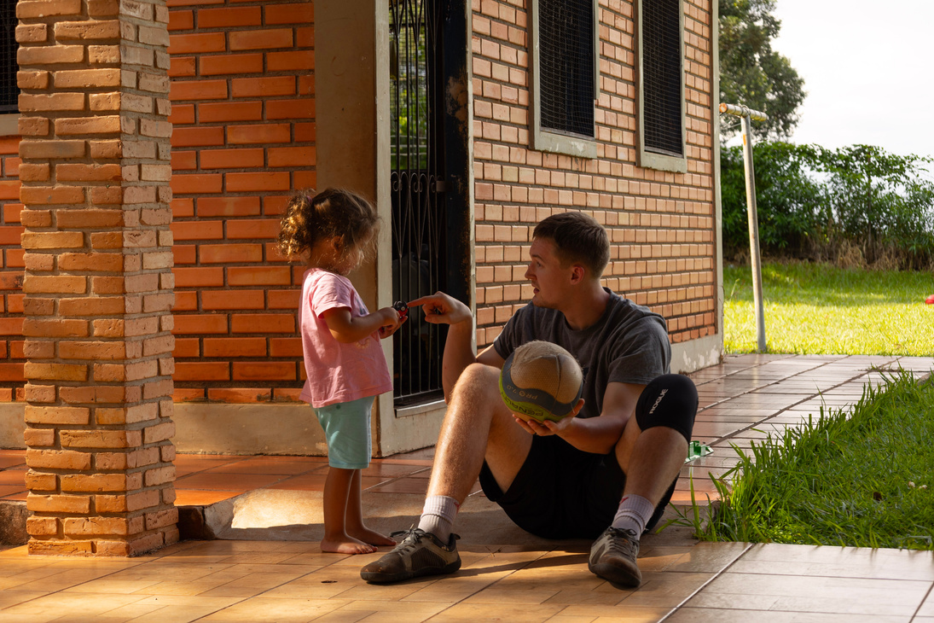
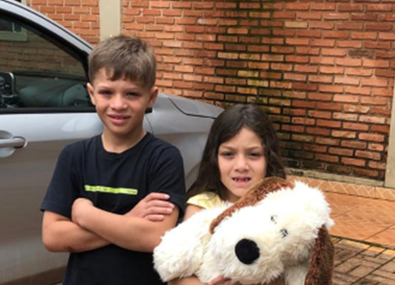
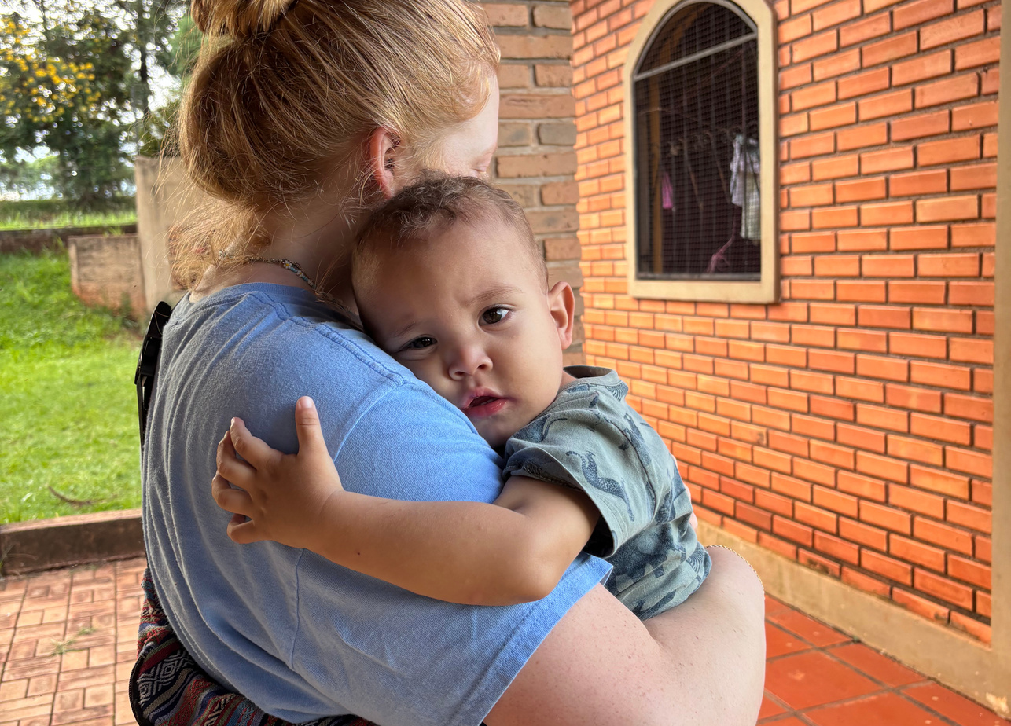
FOLLOW THEM HOME
Goal: 3000 - Remaining=$885.20
The Miriam Home’s involvement in the lives of the children doesn’t always end when the children go home. Many times we see practical needs in the homes, and we know that a helping hand would greatly help restore the family. For that reason the World Missions Committee has set up a new project “Follow Them Home.” With this project the Miriam Home and our local congregation, Lar Parana, can provide practical and spiritual support to the whole family.
MIRIAM HOME, CAMPO MOURÃO, BRAZIL

Slide 7




HOW TO GIVE TO A SPECIAL PROJECT
Head to Donate Page
Make it Recurring or One time
Head to the World Missions website and click donate, then click Special Projects.
You can make your gift a recurring gift or a one time gift. A recurring gift will take it directly from an account you choose.
Designation
Fill in Your Information
Make sure you designate what project you are donating to with the drop-dpwn arrows.
Fill in your address and form of payment.

