Slide 1
By the grace of God, making disciples of all the nations through teaching & evangelism.

Slide 2
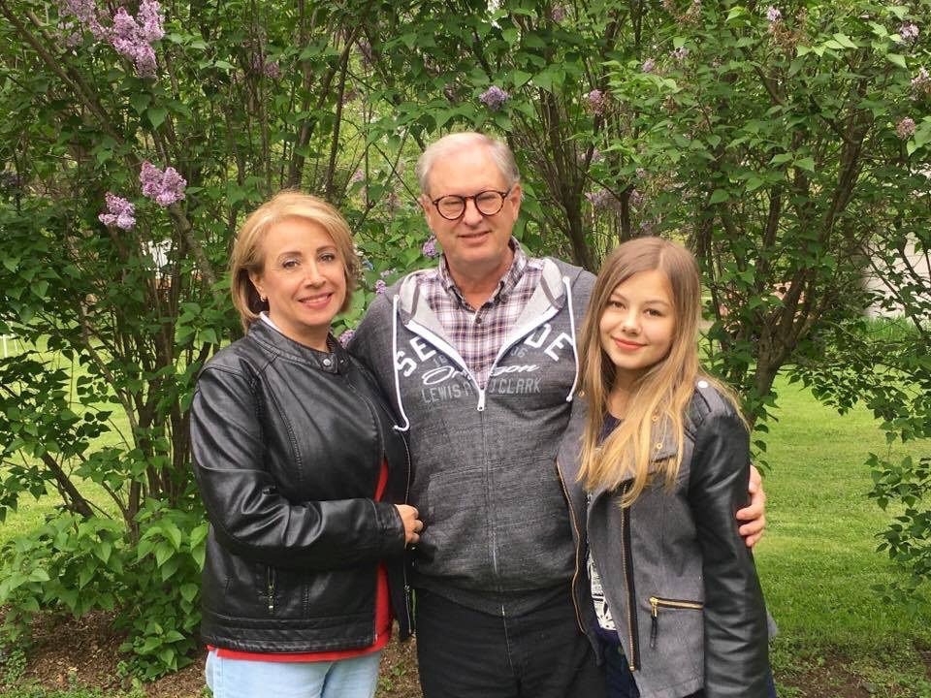
Jonathan & Tamba Abel
Pray for them:
-For health and safety
-For wisdom in working with the national people and leadership
-For health and safety

Slide 3
Jonathan & Tamba Abel
Pastor Jonathan and Tamba Abel serve a church in Maringa, Brazil. Jonathan also teaches at the Bible School in Campo Mourao on a regular basis. They are joined by their youngest child Michelle.
Pray for them:
-For health and safety
-For wisdom in working with the national people and leadership
-For health and safety

Slide 4
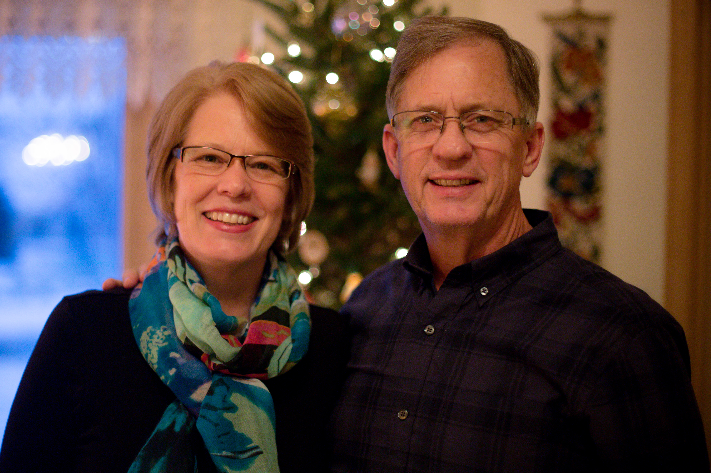
Paul & Becky Abel
Pray for them:
-For camps and retreats at the ARCA
-For faithful commitment and stability of church members
-For God’s continued provision for the work in Brazil
-For health and safety

Slide 5
Paul & Becky Abel
Pastor Paul and Becky Abel serve in Curitiba, Parana, Brazil. Their ministry focus is on church planting and the Brazil ARCA retreat center. The family has been known for their welcoming hearts and lovingly opening their home.
Pray for them:
-For camps and retreats at the ARCA
-For faithful commitment and stability of church members
-For God’s continued provision for the work in Brazil
-For health and safety

Slide 6
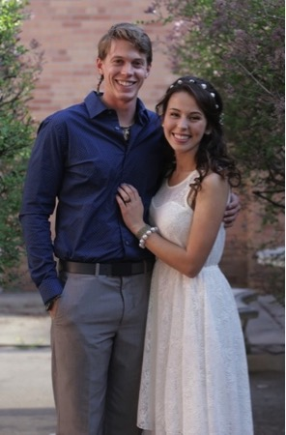
Matthew & Ednay Abel
Pray for them:
-For their marriage
-For vision and wisdom as they work with a wide rage of ministry opportunities
-For health and safety

Slide 7
Matthew & Ednay Abel
Matthew and Ednay Abel are currently serving in Brazil doing discipleship ministry. Matthew is working on his seminary degree through distance learning and Ednay finds ways to make use of her physical therapy training and share the gospel at the same time.
Pray for them:
-For their marriage
-For vision and wisdom as they work with a wide rage of ministry opportunities
-For health and safety

Slide 8
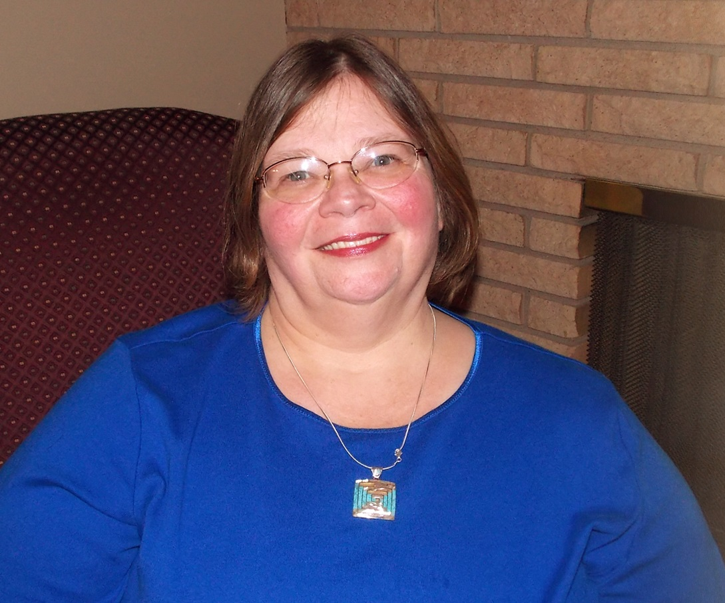
Jonni sliver
Pray for her:
-For a long-term visa to be approved
-For the partnerships of the staff and students
-For clear and creative communication and support
-For health and safety

Slide 9
Jonni sliver
Jonni serves at the Miriam Home and our Bible School and Seminary in Campo Mourao, Brazil. With a passion for children, she pours her heart into the kids, loving them and caring for their needs.
Pray for her:
-For a long-term visa to be approved
-For the partnerships of the staff and students
-For clear and creative communication and support
-For health and safety

Slide 10
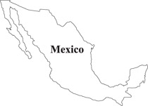
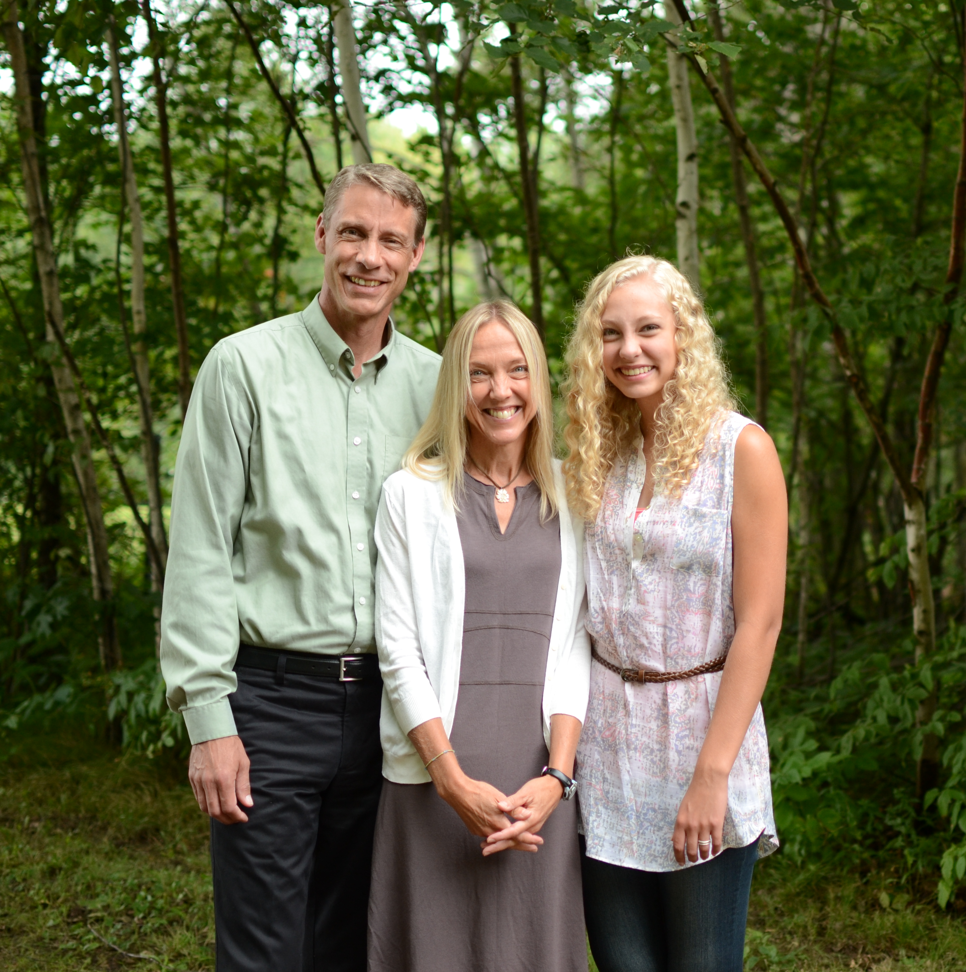
Todd & barb schierkolk
Pray for them:
-For spiritual growth of youth and their families
-For God’s wisdom and open doors regarding the purchase and construction of a church building
-For health and safety

Slide 11
Todd & barb schierkolk
Pastor Todd and Barb Scheirkolk serve a congregation and community in Mexico. They started exciting ministries with kids and families, finding that to be one of the most successful ways to reach people in their area.
Pray for them:
-For spiritual growth of youth and their families
-For God’s wisdom and open doors regarding the purchase and construction of a church building
-For health and safety

Slide 12
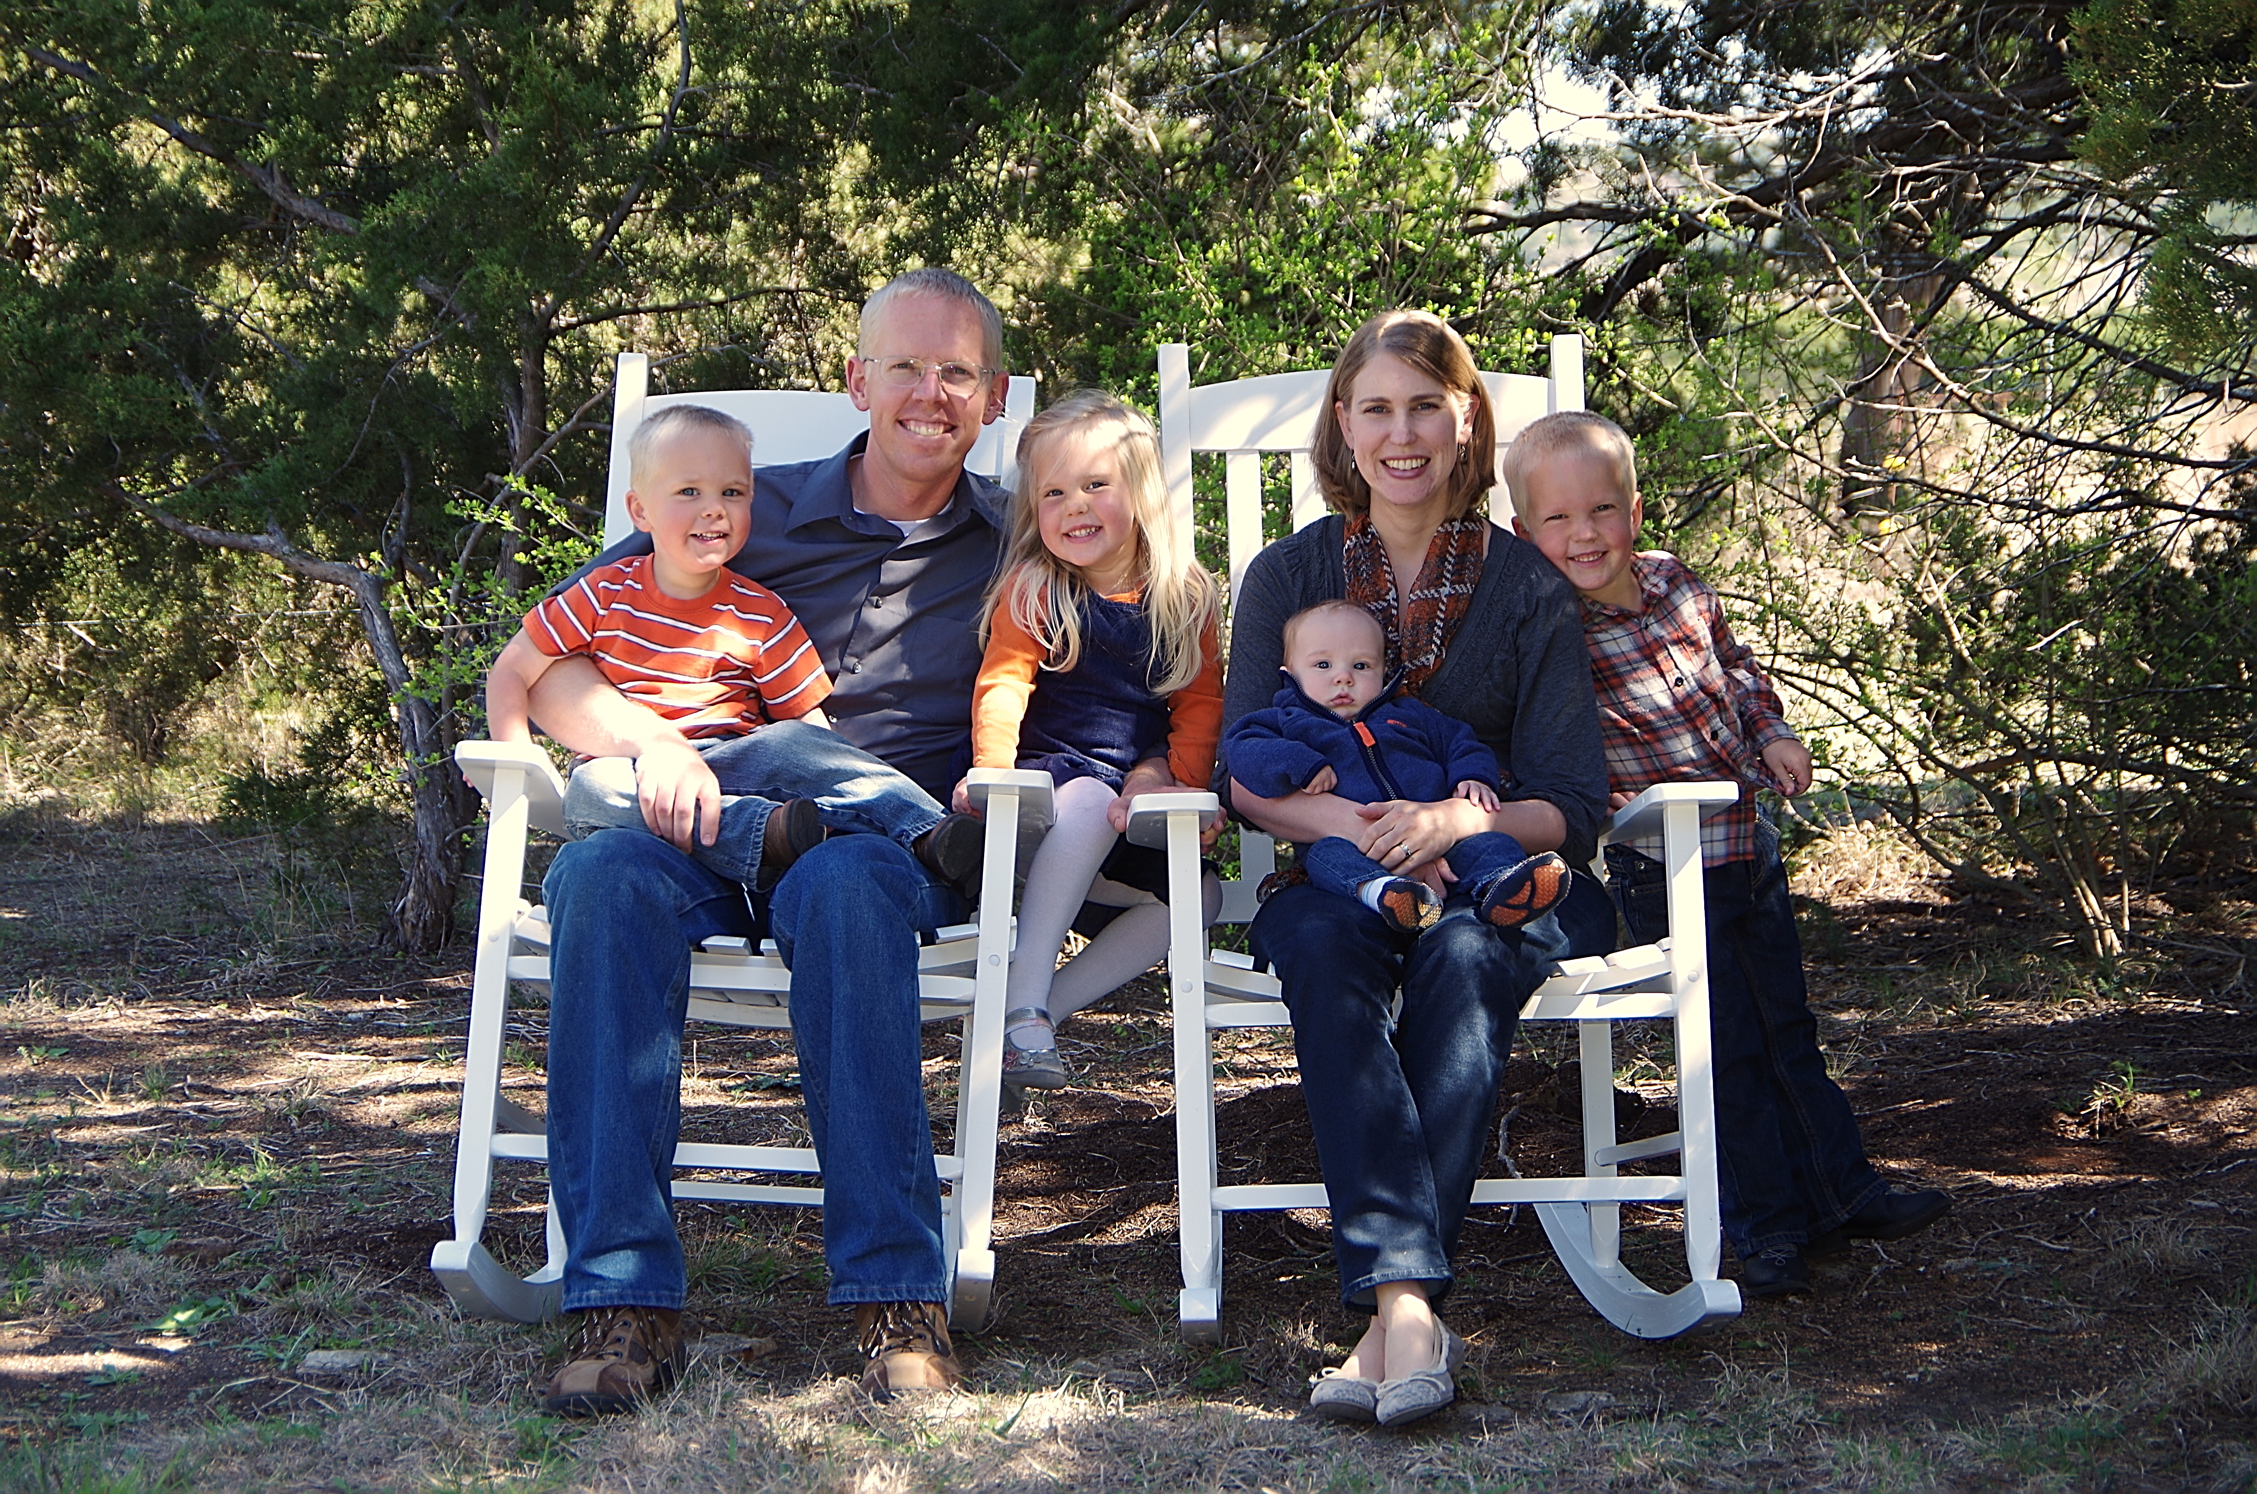
Justo & Patricia pillman
Pray for them:
-Wisdom as they schedule and work with many discipleship opportunities
-Grace for Patricia as she continues to learn Spanish
-That God would continue to bind them as a couple and unite their family
-For health and safety

Slide 13
Justo & Patricia pillman
Justo and Patricia Pillman partner with the Paz de Dios Lutheran Church (Peace of God) in Ecuador, primarily working with young adults. His activities include leading small group studies in addition to mentoring young couples. They are accompanied by their four children.
Pray for them:
-Wisdom as they schedule and work with many discipleship opportunities
-Grace for Patricia as she continues to learn Spanish
-That God would continue to bind them as a couple and unite their family
-For health and safety

Slide 14
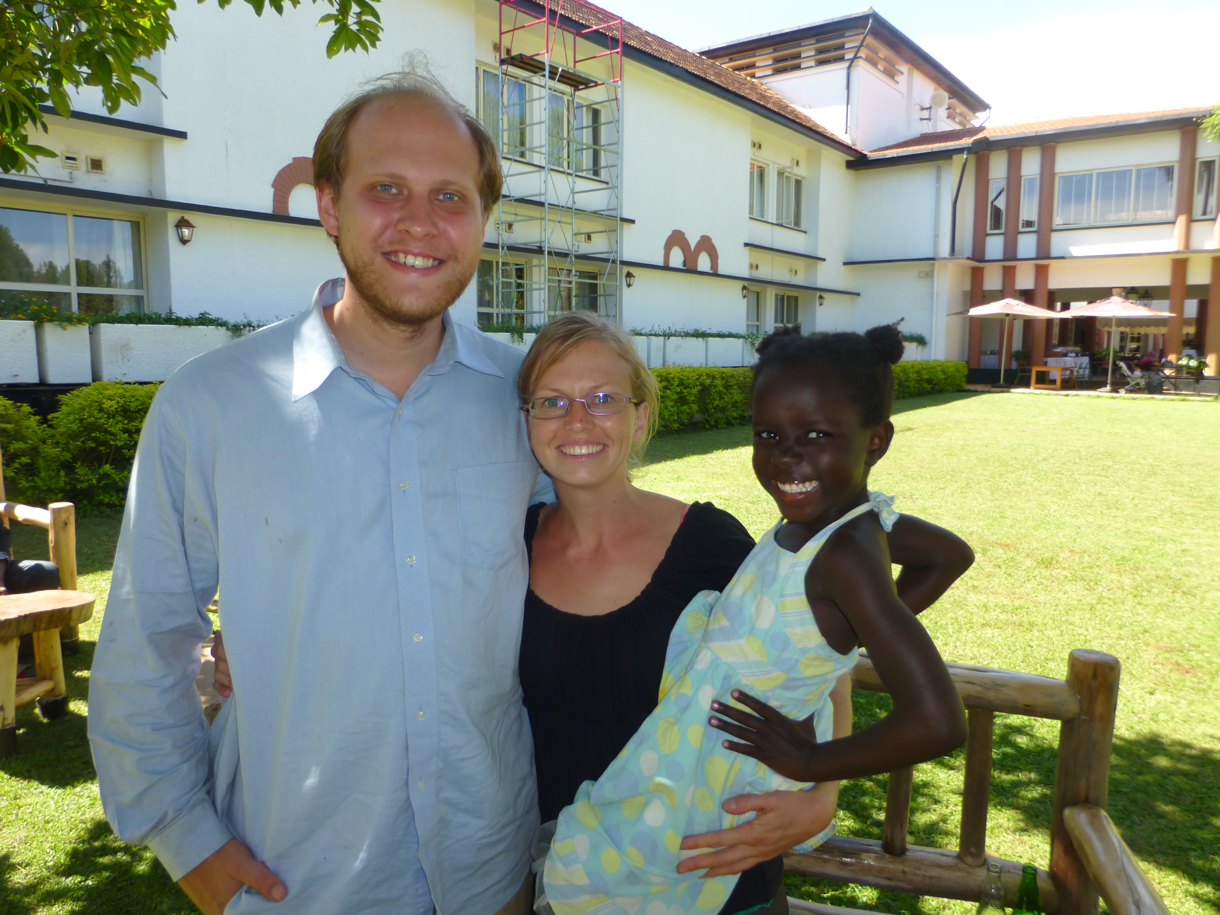
Micah & famke berger
Pray for them:
-For God’s hand of guidance upon the expansion of Ambassador Institute ministry in Uganda
-For provision of continued prayer and financial support
-For language learning
-For safety and health

Slide 15
Micah & famke berger
Micah and Famke, along with their adopted daughter Naomi, are missionaries in Karenga, Uganda. His ministry focuses on Bible teaching and disciple making through the Ambassador Institute of Uganda.
Pray for them:
-For God’s hand of guidance upon the expansion of AI ministry in Uganda
-For provision of continued prayer and financial support
-For language learning
-For safety and health

Slide 16
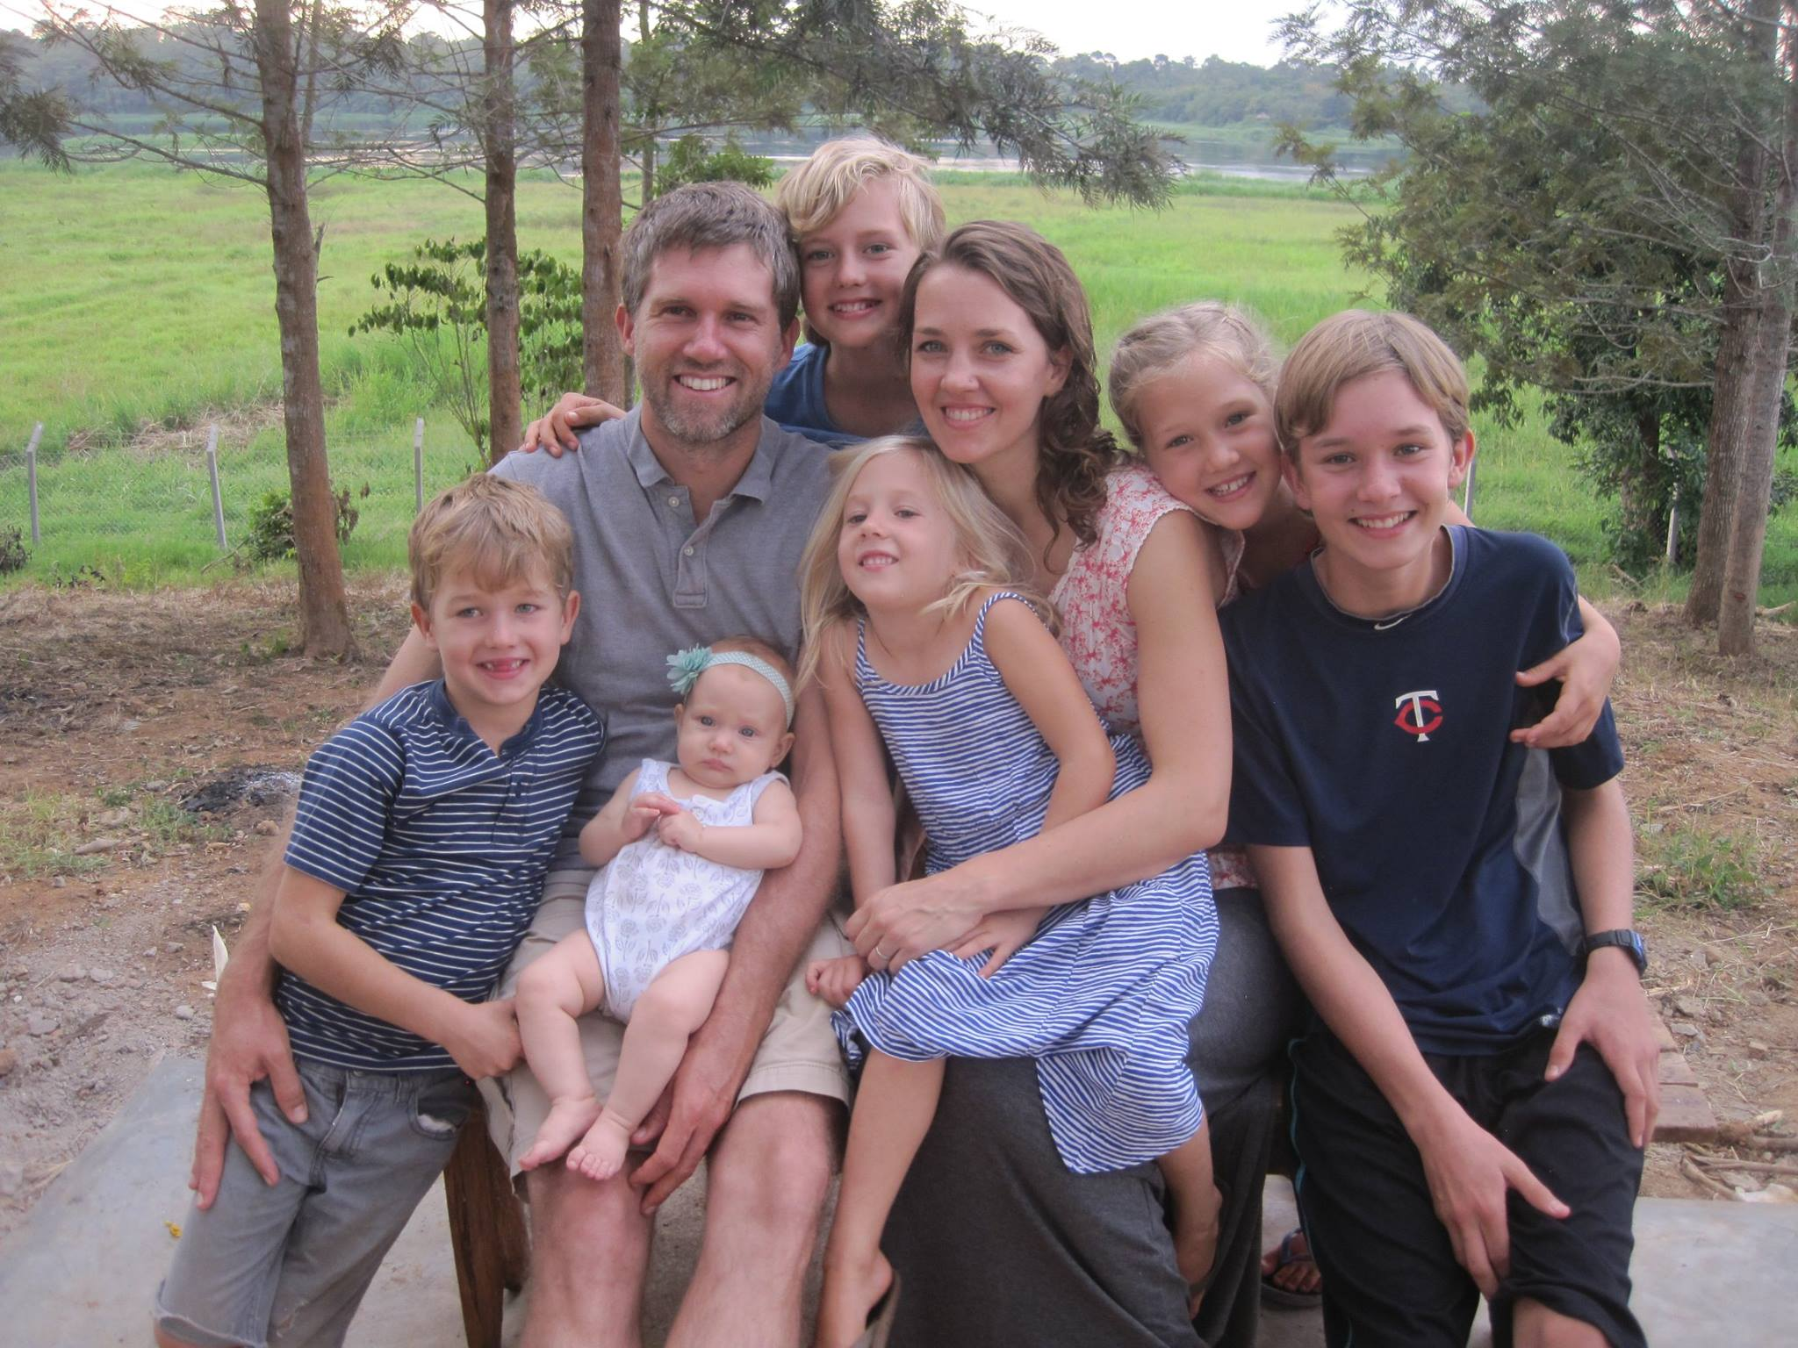
Nate & Rhoda jore
Pray for them:
-For wisdom in training and raising their children
-For protection against attacks from the evil one
-For the continued work of the AFLC in Uganda
-For vision for making disciples in the village
-For health and safety

Slide 17
Nate & Rhoda jore
Pastor Nate and Rhoda Jore and their children are serving in Uganda. They have been able to study the language and culture and build close relationships with the Ugandan people. In addition, they specifically work with the training of pastors and leaders of the churches. They are joined by their six children.
Pray for them:
-For wisdom in training and raising their children
-For protection against attacks from the evil one
-For the continued work of the AFLC in Uganda
-For vision for making disciples in the village
-For health and safety

Slide 18
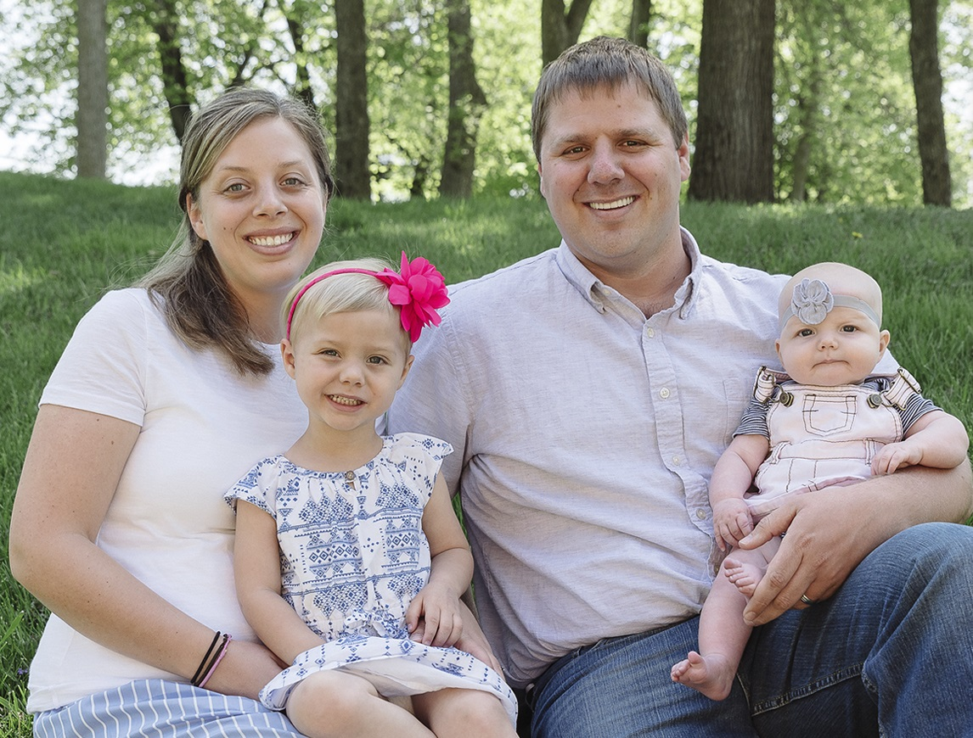
Brent & Emily Raan
Pray for them:
-For guidance and open doors concerning the upcoming stages of their ministry
-For wisdom in all they do
-For their children
For health and safety

Slide 19
Brent & Emily Raan
Pastor Brent and Emily Raan, along with their two daughters, have been called as full time missionaries to Uganda. Their first year will be spent helping out Ambassador Institute and reaching out to the Ugandan nationals and the Indian population. They have been sent with the vision of planting free and living Lutheran congregations.
Pray for them:
-For guidance and open doors concerning the upcoming stages of their ministry
-For wisdom in all they do
-For their children
For health and safety

Slide 20
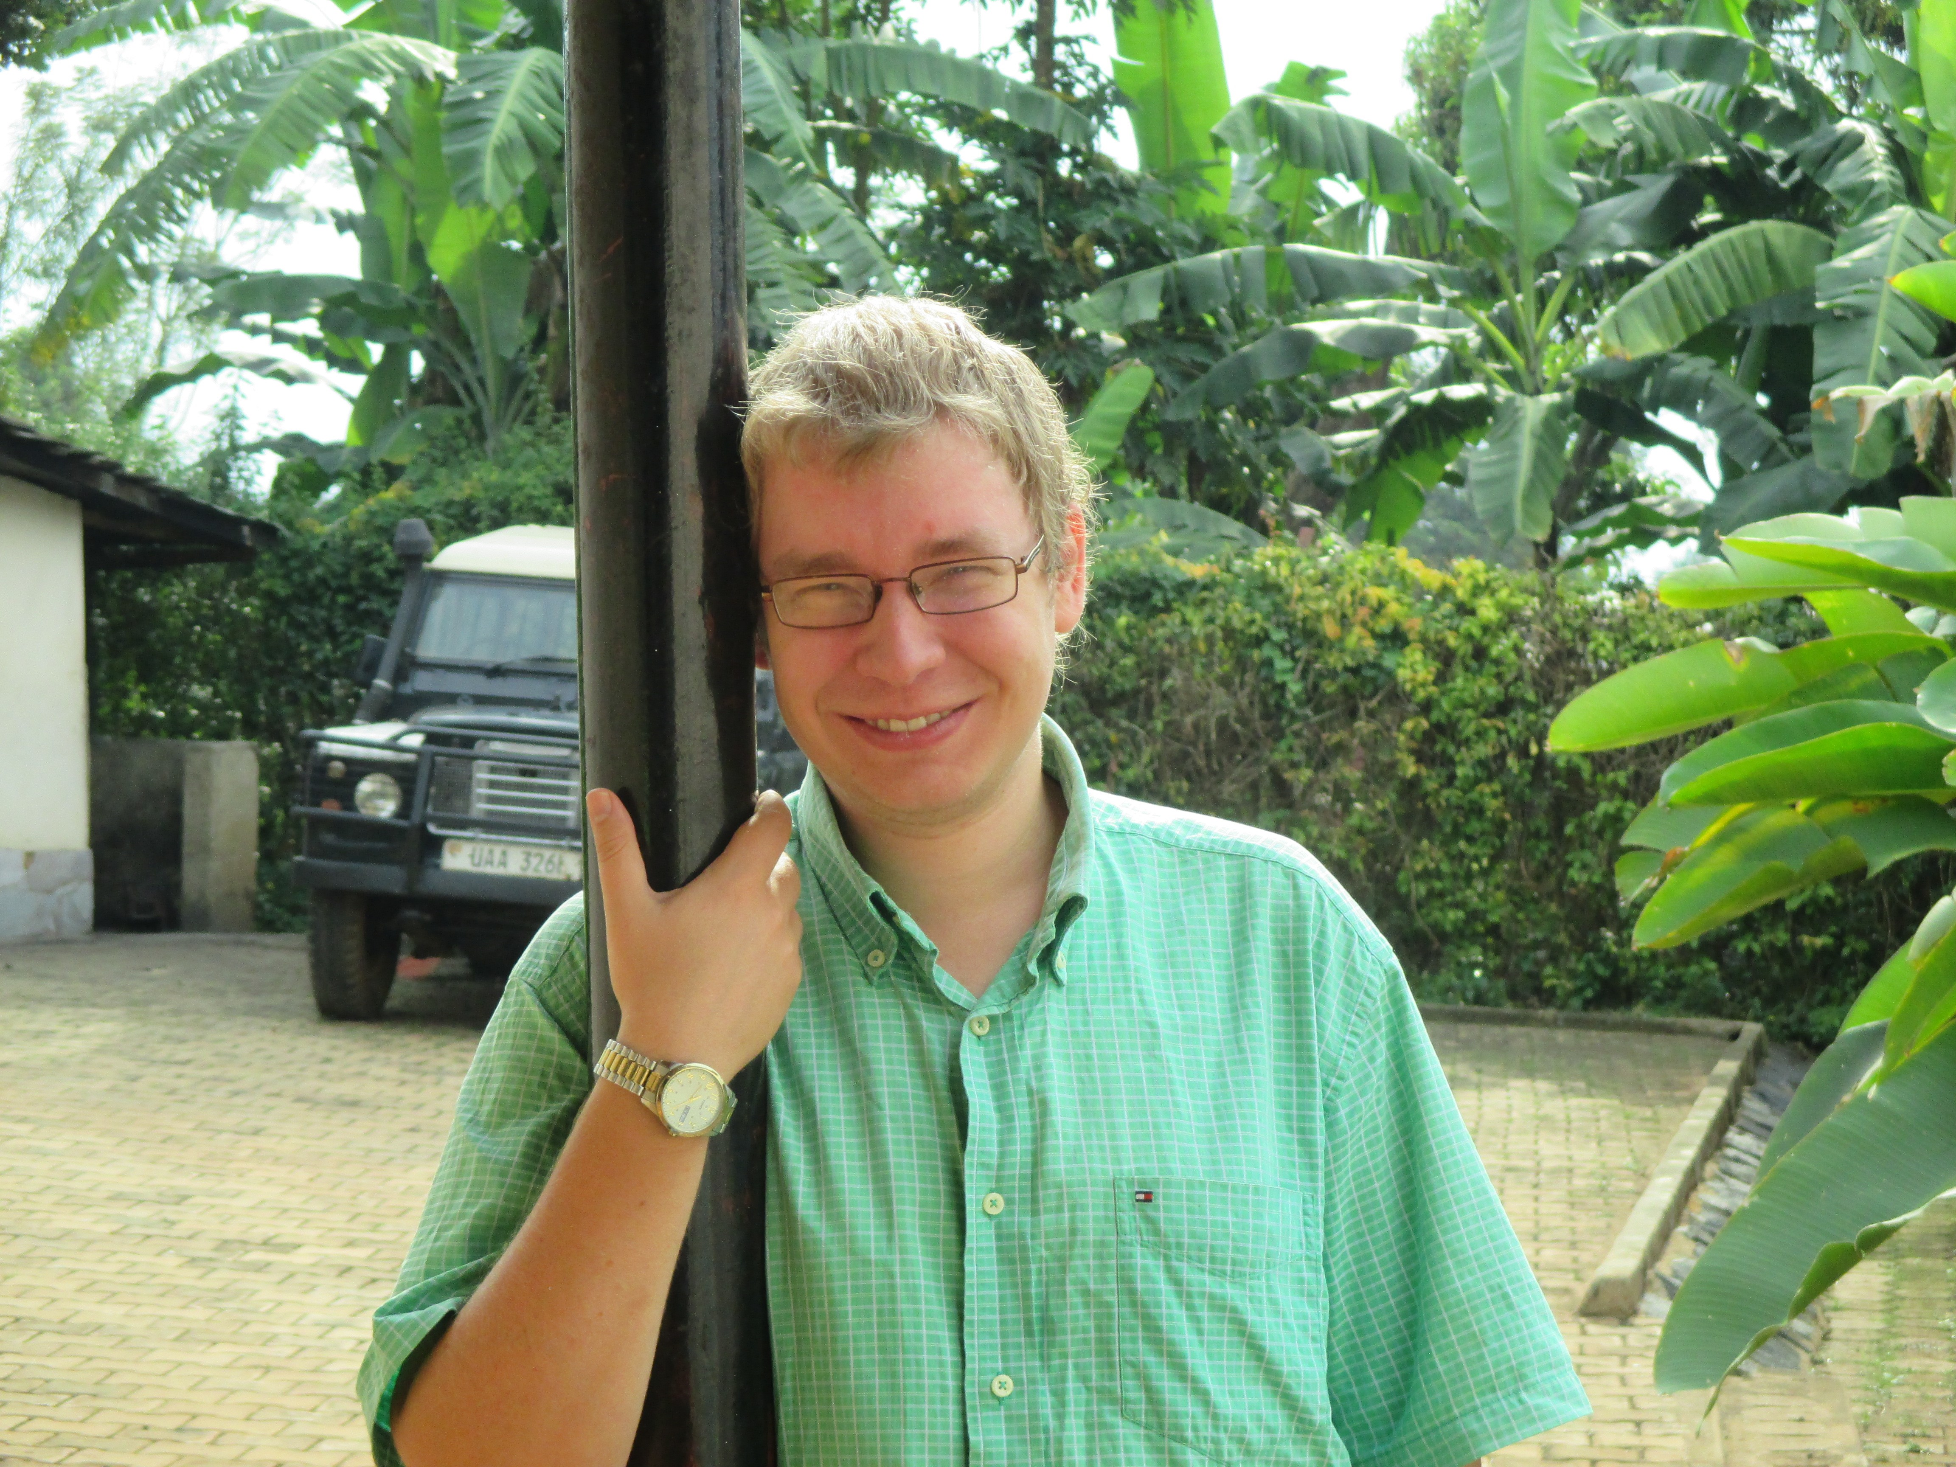
Michael Rokenbrodt
Pray for him:
-For provision of continued prayer and financial support
-For language learning
-For safety and health

Slide 21
Michael Rokenbrodt
Michael Rokenbrodt has accepted a call to be an AFLC Missionary. He will be serving as a seasonal missionary, meaning he will be on the AFLC mission field for only part of each year. From January to May, he will be teaching pastors and church leaders with our other Ugandan missionaries. Michael has served for two years as a STA. his goal to resume serving in Uganda, except now as a called AFLC Missionary. His gifts in writing, speaking, and drama are qualities that will amplify the efforts of AFLC Missions in Uganda.
Pray for him:
-For provision of continued prayer and financial support
-For language learning
-For safety and health

Slide 22
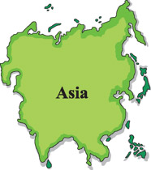
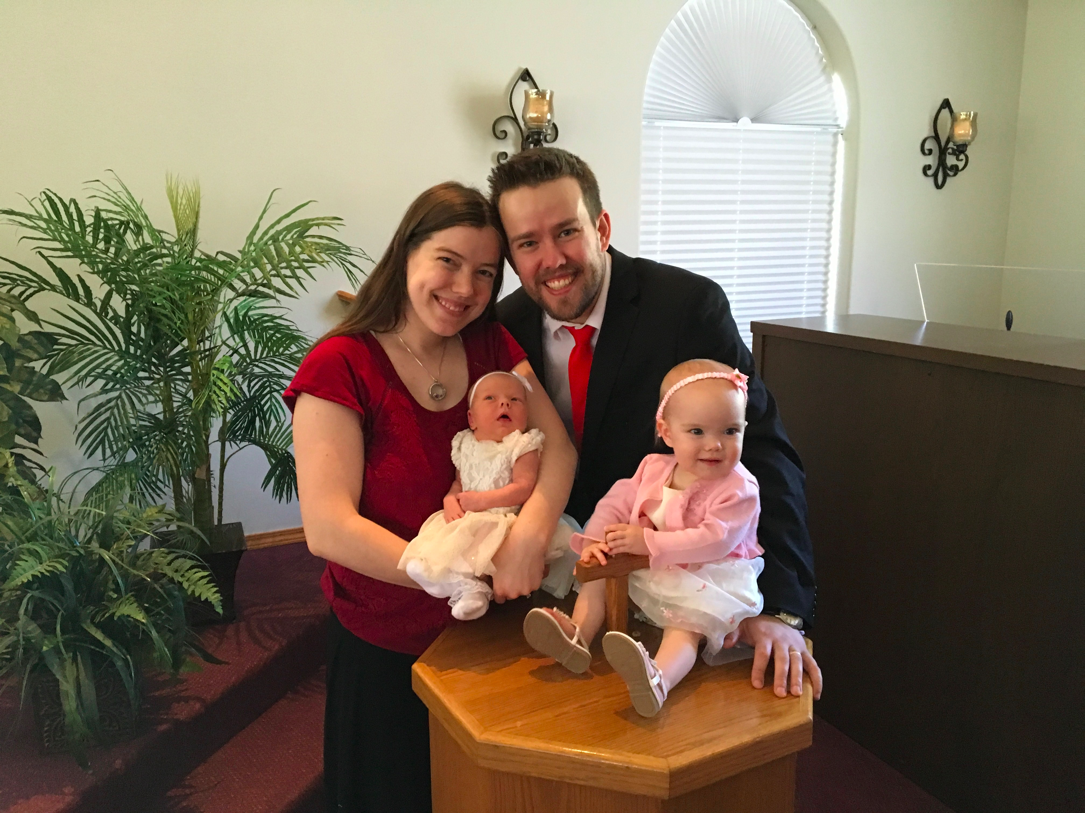
John & Hannah lee
Pray for them:
-That God would send laborers into the field of Asia to foster congregational leadership
-That these foreign nations would be welcoming to the Gospel
-That God would give them boldness and open doors to share
-For wisdom, health, and safety as they travel across the country on deputation

Slide 23
John & Hannah lee
John and Hannah Lee have accepted a call from AFLC World Missions to serve in Asia. They will spend the first year learning the culture and language followed by church planting, nourishing, and training. The Lees have two daughters.
Pray for them:
-That God would send laborers into the field of Asia to foster congregational leadership
-That these foreign nations would be welcoming to the Gospel
-That God would give them boldness and open doors to share
-For wisdom, health, and safety as they travel across the country on deputation

